Slide 1
Glass Filler
Group #04 : Stuxnet

Slide 2
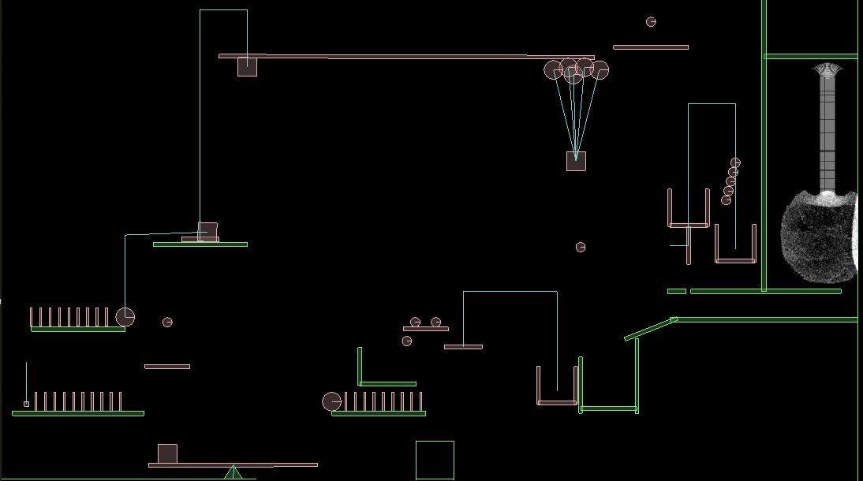
Initial State
Notes:
Explain the working through the diagram to the audience

Slide 3
Liquid and Balloons
This project simulates water in a new and less taxing way .
Instead of using various balls and defining properties for it everytime, it uses particle groups defined by Google in their Liquidfun version of Box2D
It still does take a lot out of a computer’s RAM but for now it is one of the most proficient methods of doing it.
For Balloons, as there is no concept of air pressure yet without introducing thousands of particles, we used a gravity mod for the body and it may not work exactly according to physics, but the values can be set to simulate it in the real world.

Slide 4
Timing
The other thing that stands out the most in this project is the impeccable timing of the mechanism .
It doesn’t wait for the water to completely fill up and then spill to the other container to start the workings.
It makes use of the initial fast speed of the water stream to start the workings right away .
The mechanism ends exactly when the glass is filled and doesn’t let too much of water to go to waste if implemented in real world.

Slide 5
Designing
As we started right away, it gives us a lot of flexibility and saves the problem of too much water spilling out of the screen borders and eating up extra memory.
The mechanism can now be defined in a simpler way because if water starts spilling, increase depth of glass and if mechanism ends way too early for your liking , then reduce depth of glass.
This flexibility makes designing much easier for anyone without worrying too much about timing everything perfectly.

